Slide 1
Firewall
Prepared By :
S.Nirmala

Slide 2
FIREWALL
A firewall is a network security system, either hardware- or software-based, that uses rules to control incoming and outgoing network traffic.
A firewall acts as a barrier between a trusted network and and an untrusted network.

Slide 3
Milestone
Types of Firewalls
Packet filtering firewall
Application proxy firewall
Stateful inspection firewall
G uard
Personal Firewall

Slide 4
Types of Firewall

Slide 5
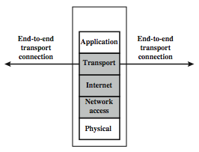
Packet Filtering Firewall

Slide 6
Packet Filtering Firewall
A packet filtering firewall applies a set of rules to each incoming and outgoing IP packet and then forwards or discards the packet.
Filtering rules are based on information contained in a network packet.
Source IP address
Destination IP address
Source and destination transport level address
IP protocol field
Interface

Slide 7
Packet Filtering Firewall
Two default policies are there to take default action to determine whether to forward or discard the packet.
Default = discard
Default = forward
Some possible attacks on firewall :
IP address spoofing
Source routing attacks
Tiny fragment attacks

Slide 8
Packet Filtering Firewall
Advantage :
Cost
Low resource usage
Best suited for smaller network
Disadvantage :
Can work only on the network layer
Do not support complex rule based support
Vulnerable to spoofing

Slide 9
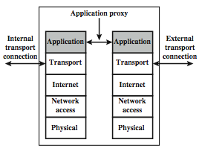
Application Proxy Firewall

Slide 10
Application Proxy Firewall
An application – level gateway, also called an application proxy, acts as a rely of application – level traffic.
user requests service from proxy.
proxy validates request as legal.
then actions request and returns result to user.
can log / audit traffic at application level.

Slide 11
Application Proxy Firewall
Advantage :
More secure than packet filter firewalls
Easy to log and audit incoming traffic
Disadvantage :
Additional processing overhead on each connection

Slide 12
Stateful Inspection Firewall
A stateful inspection packet firewall tightens up the rules for TCP traffic by creating a directory of outbound TCP connections.
There is an entry for each currently established connection.
The packet filter now allow incoming traffic to high – numbered ports only for those packets that fit the profile of one of the entries in this directory.
A stateful packet inspection firewall reviews the same packet information as a packet filtering firewall, but also records information about TCP connections.

Slide 13
Stateful Inspection Firewall
Advantage :
can work on a transparent mode allowing direct connections between the client and the server
can also implement algorithms and complex security models which are protocol specific, making the connections and data transfer more secure

Slide 14
GUARD
A guard is a sophisticated firewall. Like a proxy firewall, it receives protocol data units, interprets them, and passes through the same or different protocol data units that achieve either the same result or a modified result.

Slide 15
Personal firewall
A personal firewall is an application program that runs on a workstation to block unwanted traffic, usually from the network.

Slide 16
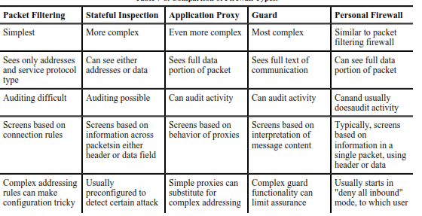
Comparison of Firewall Types

Slide 17
Thank
☺
You

